Slide 1
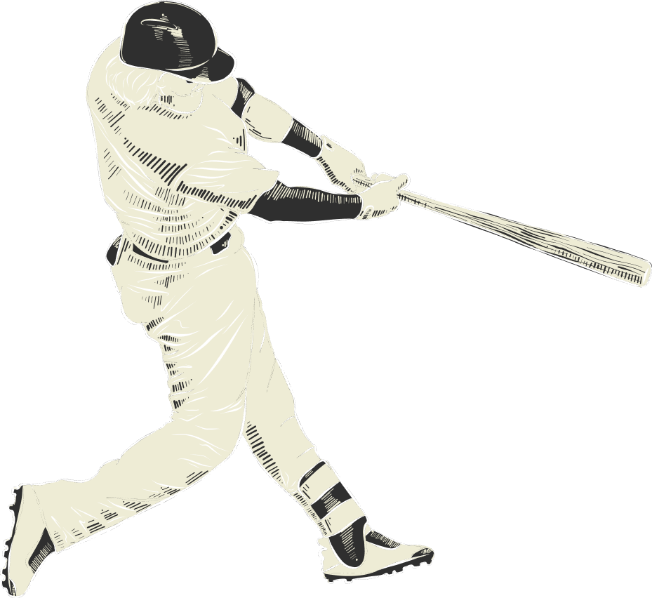


SEI x Phillies 2024 Hackathon
Estimating Strike Probabilities Through Umpire Tendencies
By: Kale Wiley, Gibson Hurst, Michael Mucciolo, Cara Fredericks
Temple University, Fox School of Business, Statistical Science & Data Analytics

Slide 2
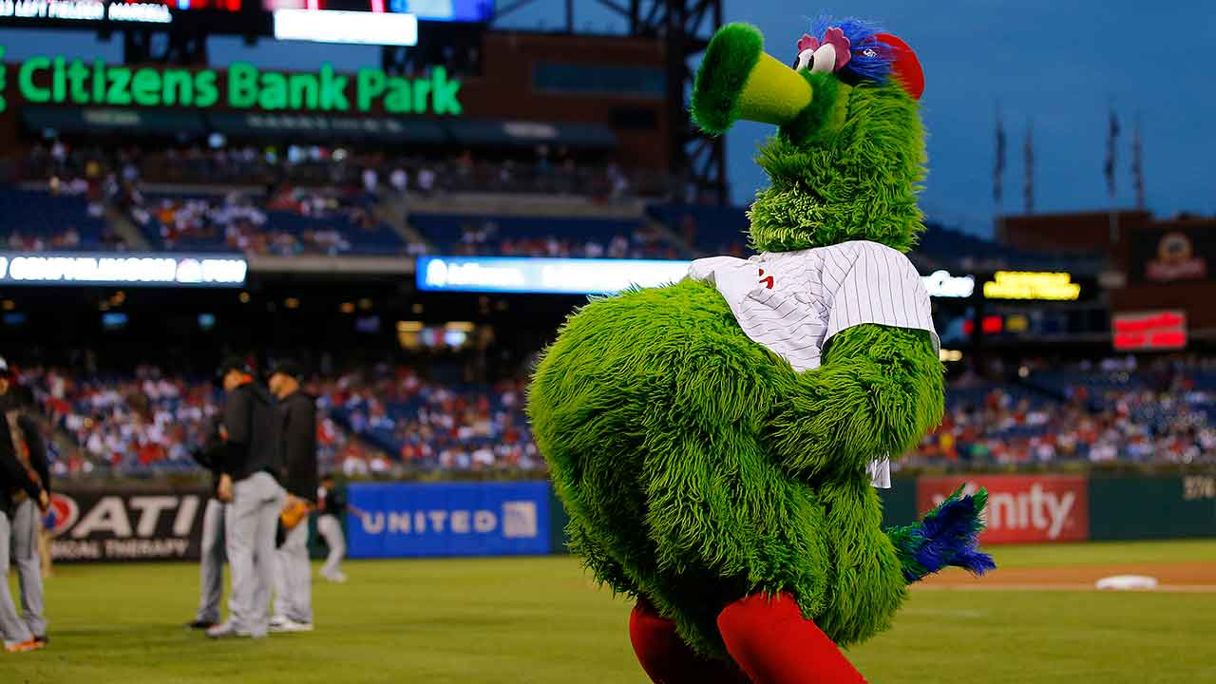
Agenda
Project Overview
Dataset
Audience & Application
Methodology
Model Development and Evaluation
Limitations & Future Directions
Conclusion
1

Slide 3
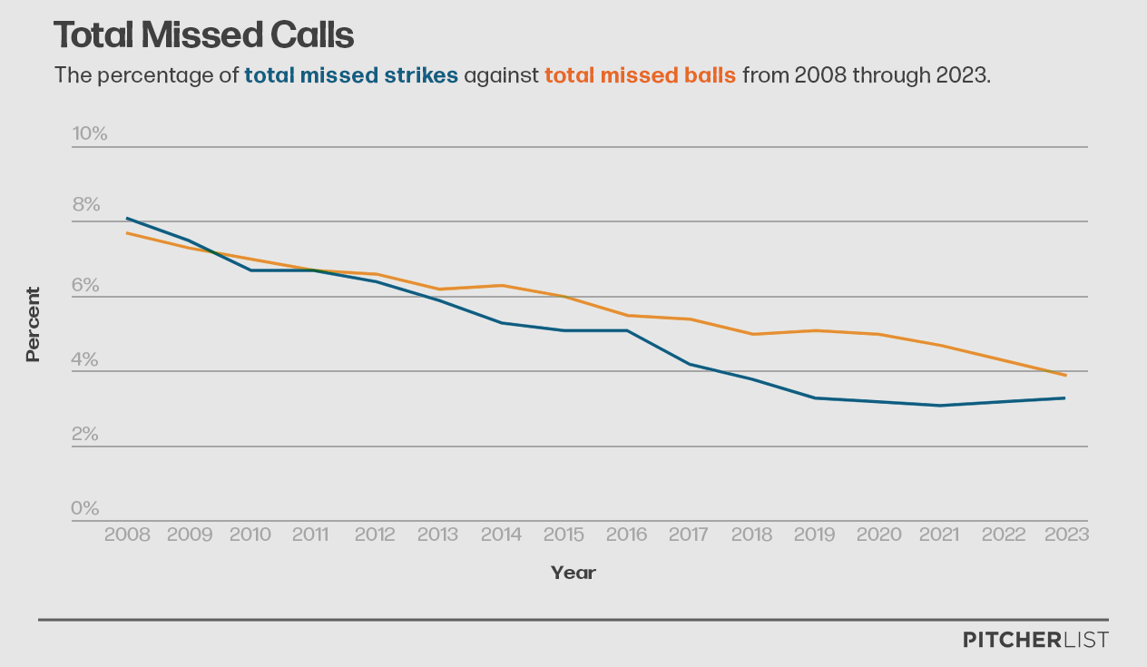
Eyes on Umpires
About 50% decrease in total missed calls
The MLB released data to the public beginning in 2008
More eyes on umpire performance & increases data availability → increased call accuracy
2
Notes:
The graph shows the percentage of total missed strikes (in blue) against total missed balls (in orange) from the 2008 MLB season to the 2023 MLB season. We see that total missed strikes has decreased more over the years, though total missed balls has had a slower decline. Over the 15 year span, we saw about a 50% decrease in total missed calls.
Because people have cared more about analytics in baseball, that is why the total number of missed calls has decreased, people have been more critical of umpires since having access to this data
Since this system has been put into place, umpires have become more accurate with their calls
Through our predictive model, we aim to discover just how accurate umpires with in the 2022 MLB season.
Though we’ve seen an increase in umpire accuracy over the years, we aim to discover just how accurate were the umpires during the 2022 MLB season.

Slide 4
Project Overview
Goal: Develop a predictive model to estimate the probability of a taken pitch being called a strike in baseball
Plan: Analyze data from the 2022 MLB regular season to understand umpire tendencies and pitch dynamics
Application: To enhance decision-making for baseball teams by providing insights into catcher framing, swing decisions, and umpire behavior
Deliverables:
A strike probability model
Product to display predicted called strike probabilities
3

Slide 5

Dataset Information
All 2022 MLB regular season pitches
Sourced from basebalsavant.mlb.com
2,430 games
870 different pitchers
351,062 pitches
235,194 called balls
115,868 called strikes
Both the expected call and actual umpire call for each pitch are included
4

Slide 6
Feature Engineering
balls_plus_strikes: Number of overall pitches in the count at the time of the pitch
in_strikezone: A binary value of whether a given pitch was in the strike zone (zones 1-8) or not
same_side: Whether the pitcher had the same stance as the batter (RHP and RHB for example)
abs_value_plate_x: Absolute horizontal distance of the ball from the center of home plate
plate_z_corrected: Vertical distance of the ball from the vertical midpoint of the batter’s strike zone
abs_value_plate_z: Absolute vertical distance of the ball from the vertical midpoint of the batter’s strike zone
description_binary: Converting description column variables to binary (1 for called_strike and 0 for ball)
5

Slide 7
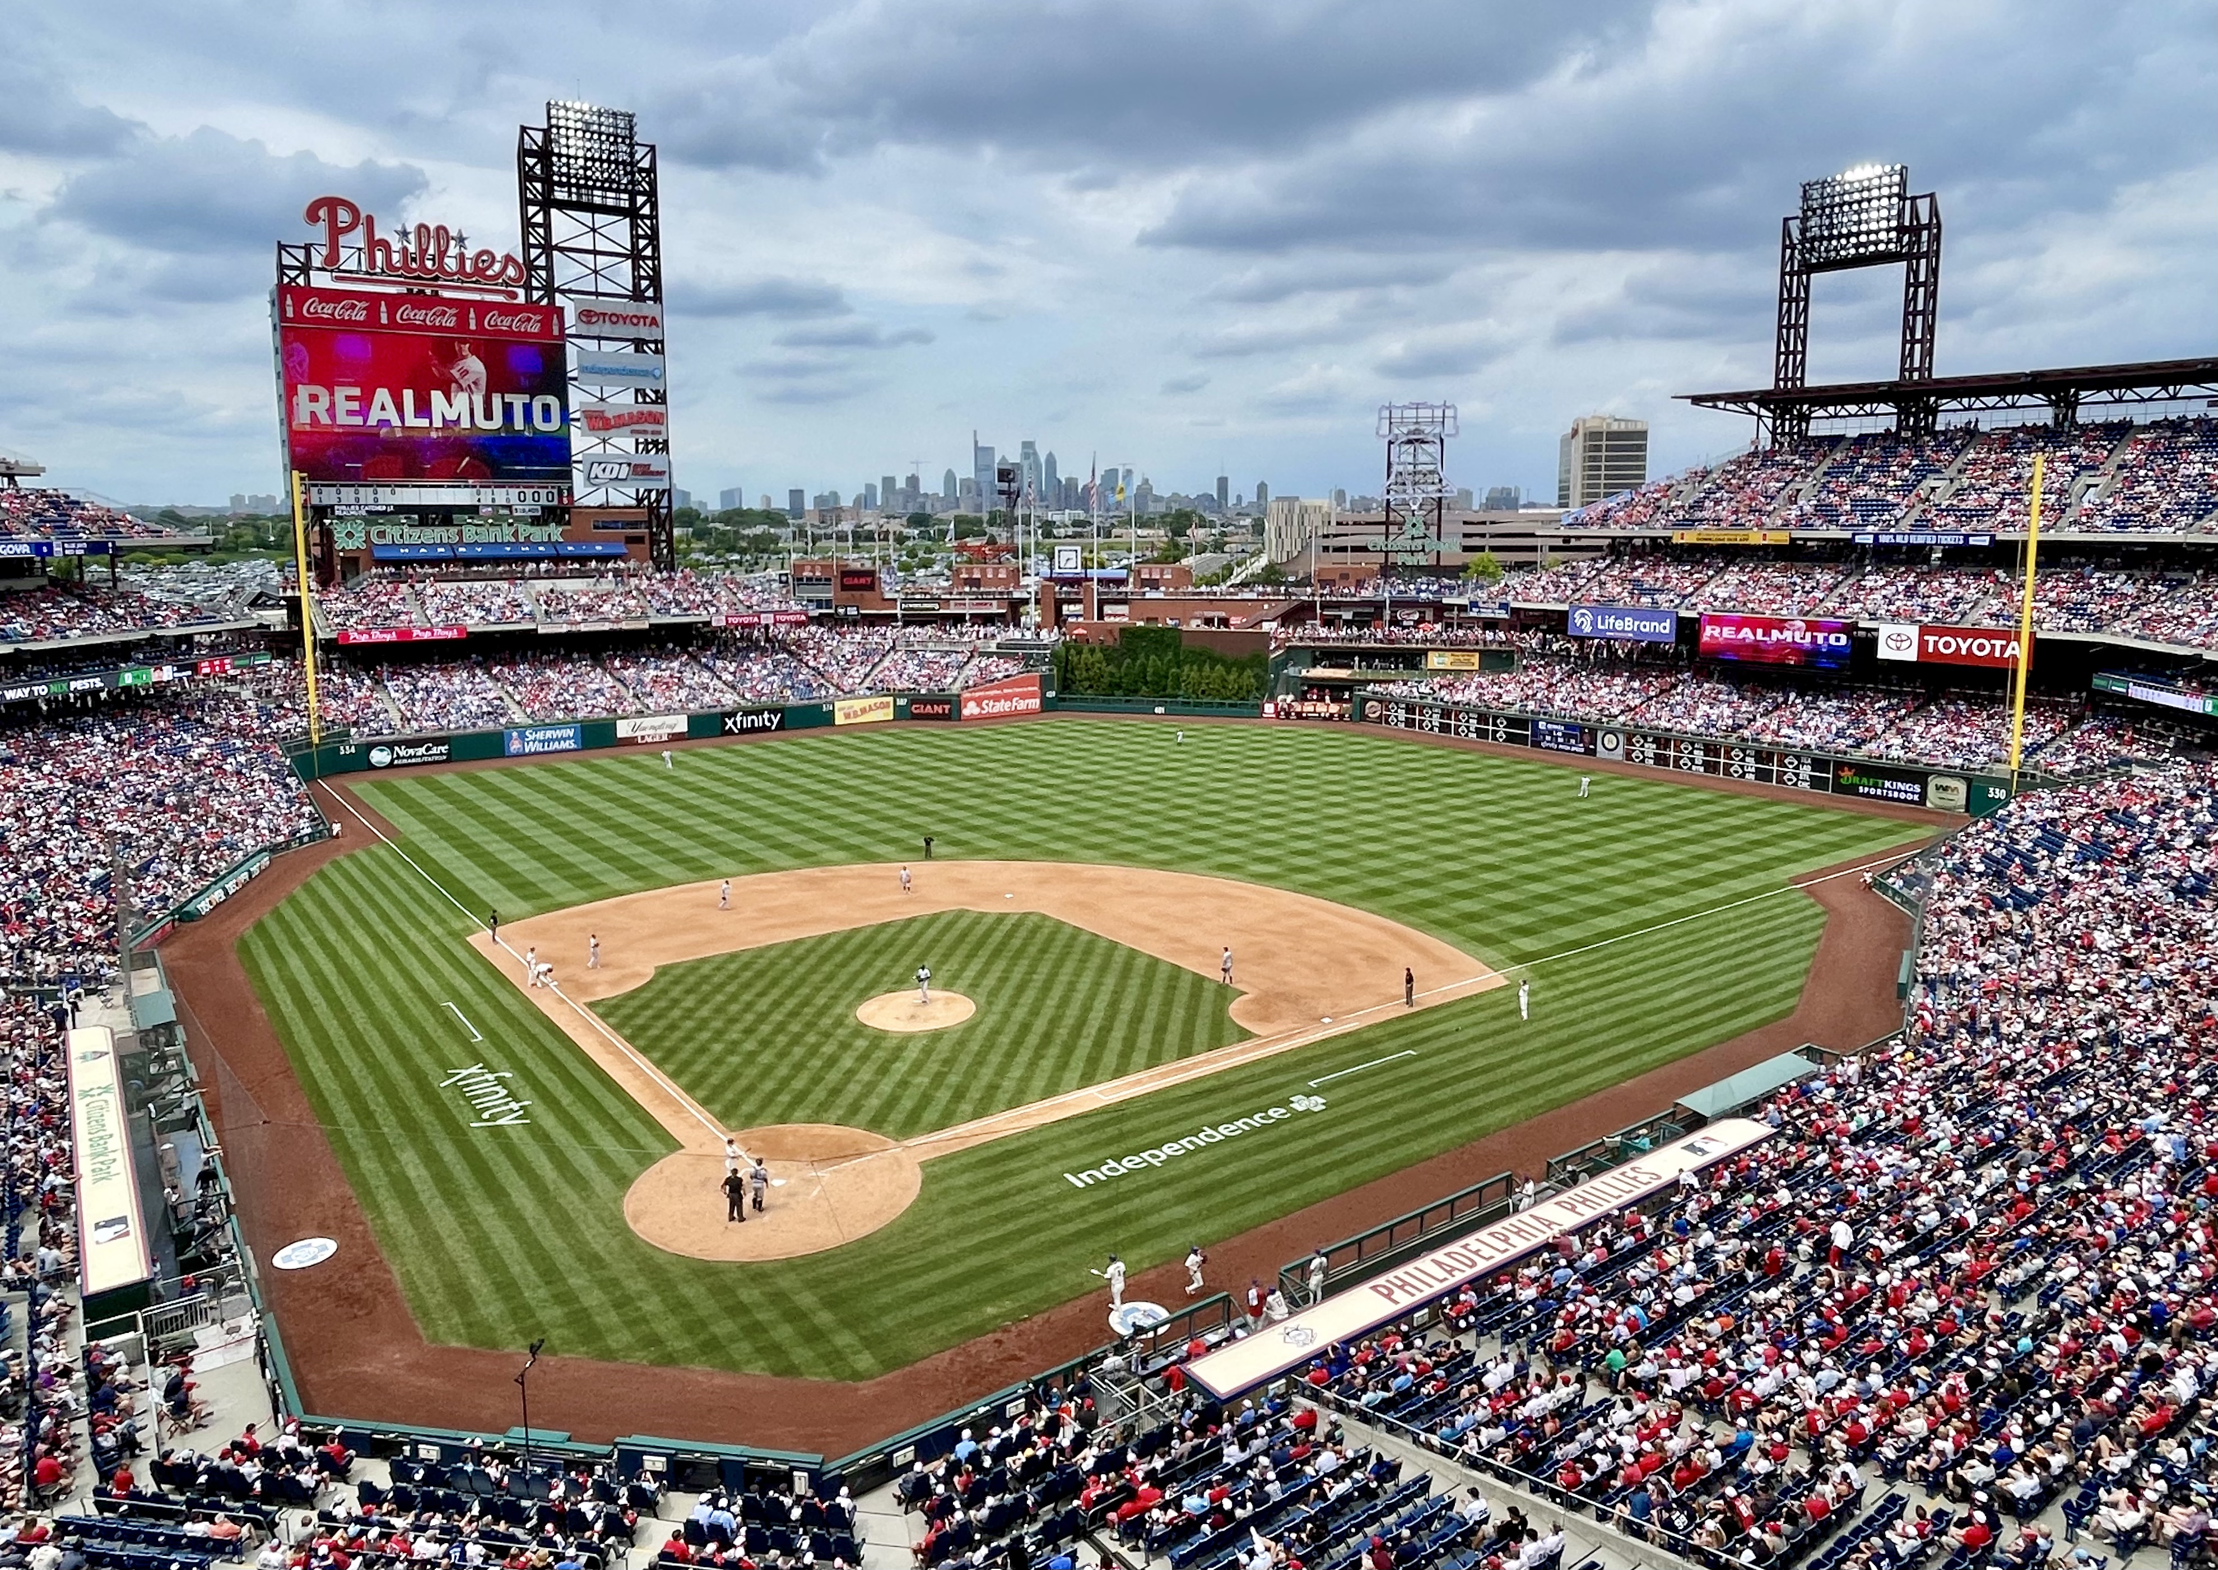
Audience and Application
Baseball teams and coaches
Assessing umpire performance
Sports Analysts for quantifying player performance
Scouting
Baseball fans and enthusiasts
6

Slide 8
Methodology
Exploratory Data Analysis:
Investigated umpire accuracy through a comprehensive strike zone examination
Model Development:
Utilized logistic regression suitable for handling categorical, binary, and numerical variables (Umpire's calls of 'called_strike' were coded as 1, and 'called_ball' as 0)
Evaluation Metrics:
Developed a deviance residuals plot to assess the model's normality
Validation:
Verified the model's performance using unseen data
7

Slide 9
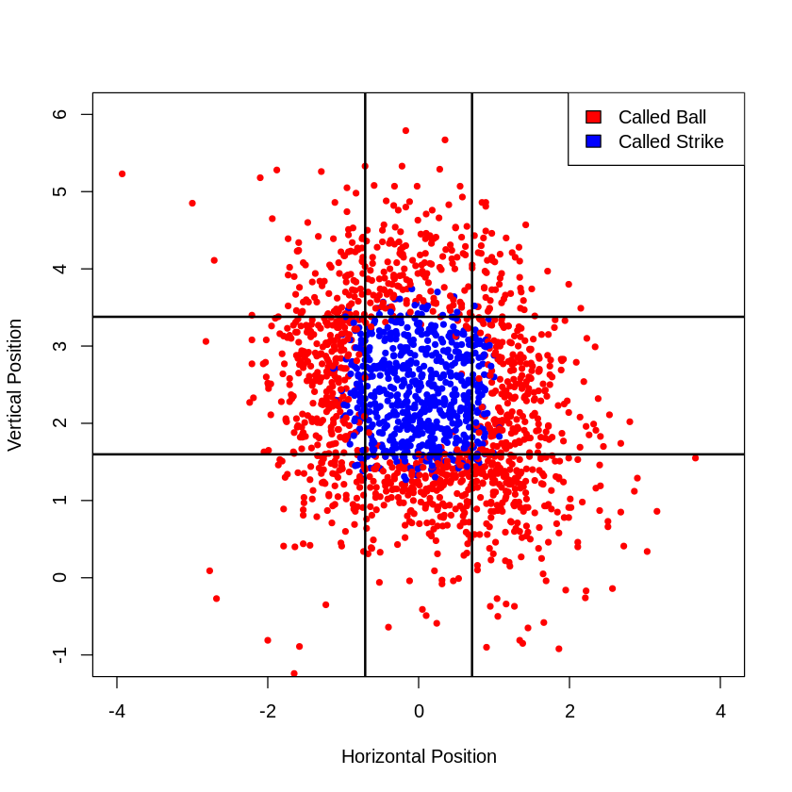
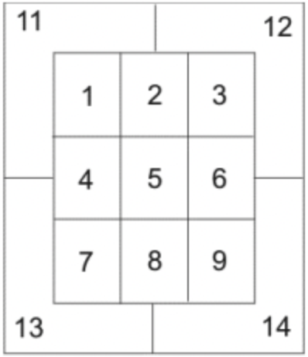
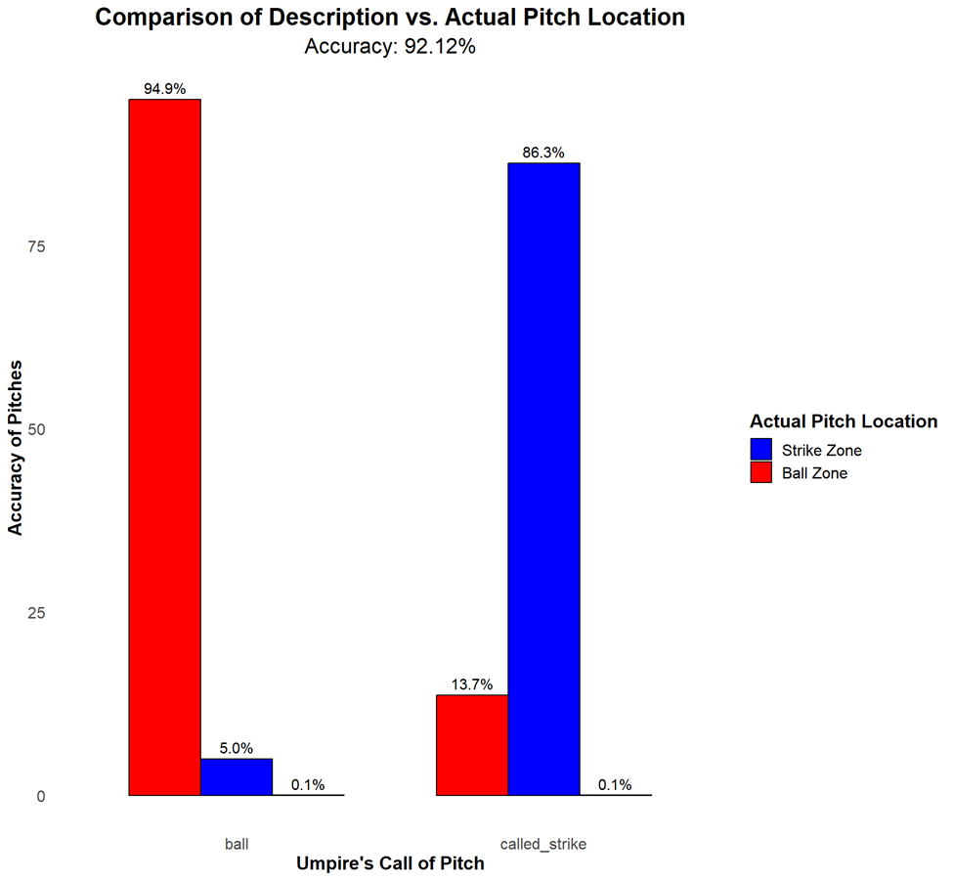
Umpire Accuracy EDA
8

Slide 10
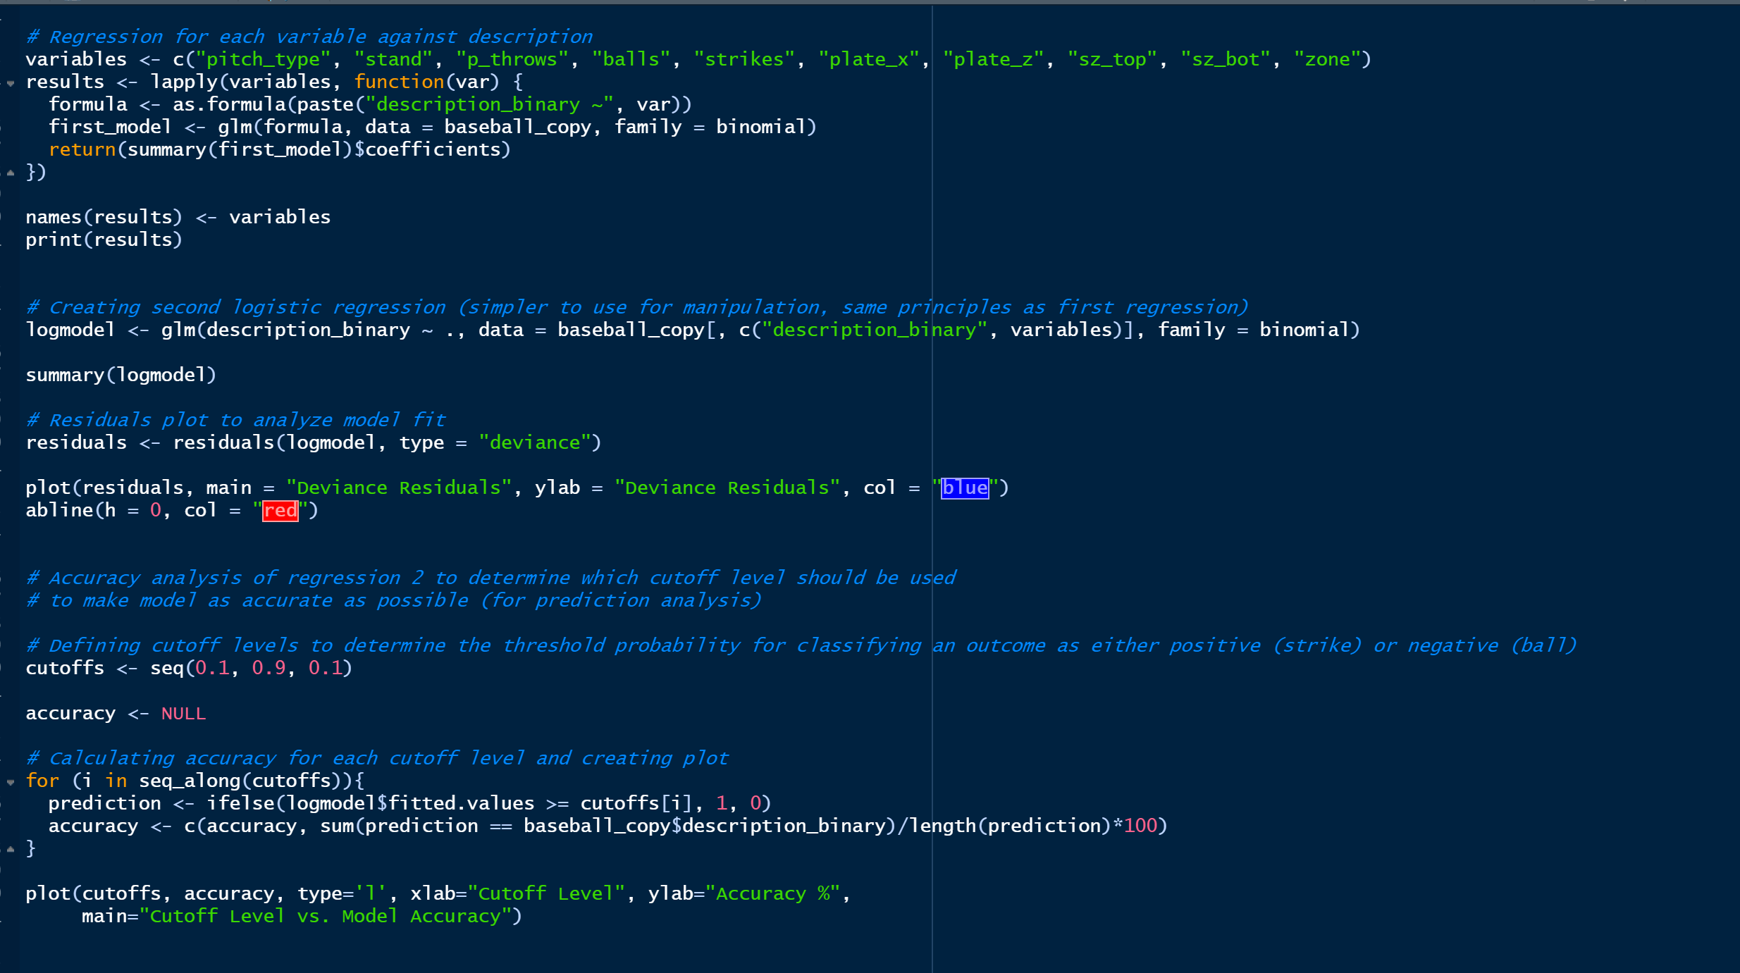
Model Development (Regression Analysis)
Created a logistic regression model to determine how significant each variable is against umpire call
Analysis revealed that:
Pitches with positive coefficients had higher chance of being called a strike
Pitches on outside of strike zone are most likely to be called incorrectly
Higher strike counts reduced the likelihood of the pitch in question being called a strike
9

Slide 11
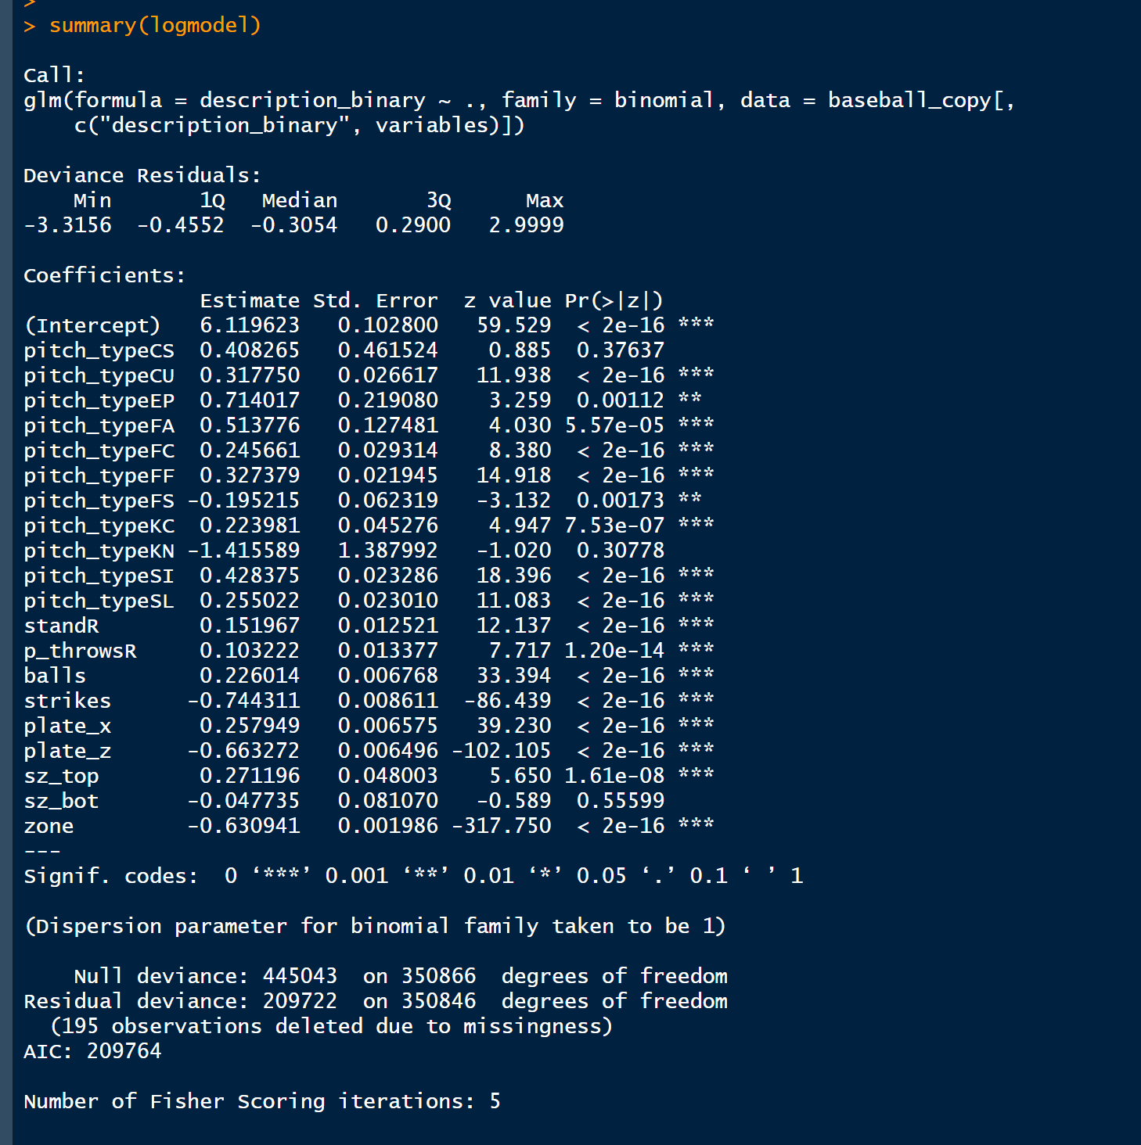
Model Development (Regression Analysis)
10

Slide 12
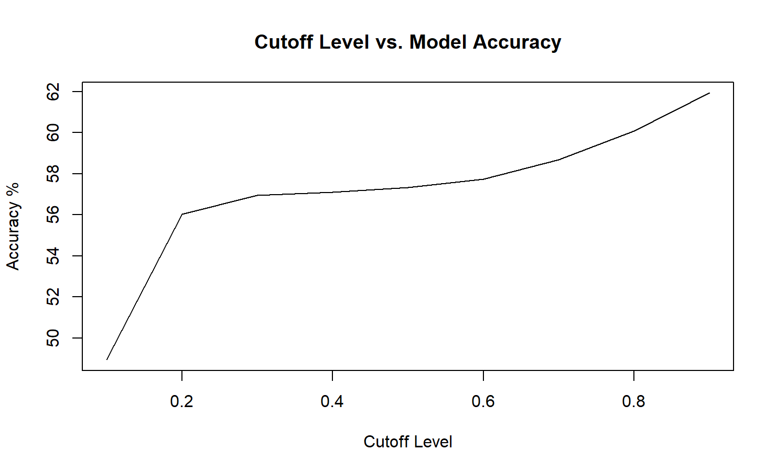
Model Development (Cutoff Level)
Conducted an accuracy analysis using different cutoff levels ranging from 0.1 to 0.9 using an increment of 0.1
Accuracy is calculated from the model based on whether the pitch was called a strike or a ball
The plot provides a visual representation of the relationship between cutoff levels and accuracy
11
Notes:
Lower cutoff level means more false positives and fewer false negatives
Higher cutoff level could lead to fewer false positives and more false negatives

Slide 13
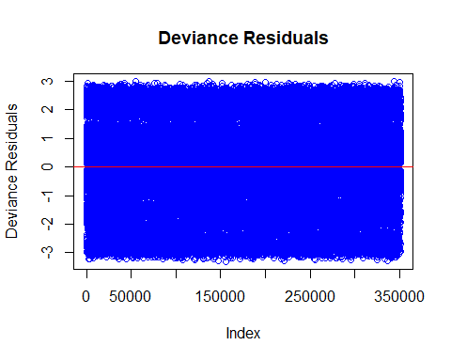
Model Evaluation (Deviance Residuals)
The blue residuals are evenly scattered above and below the line at y=0
Even scatter suggests normality
Residuals above or below 0 show underprediction of strike or ball
Indicates the model is unbiased in its predictions and fits the data
12

Slide 14
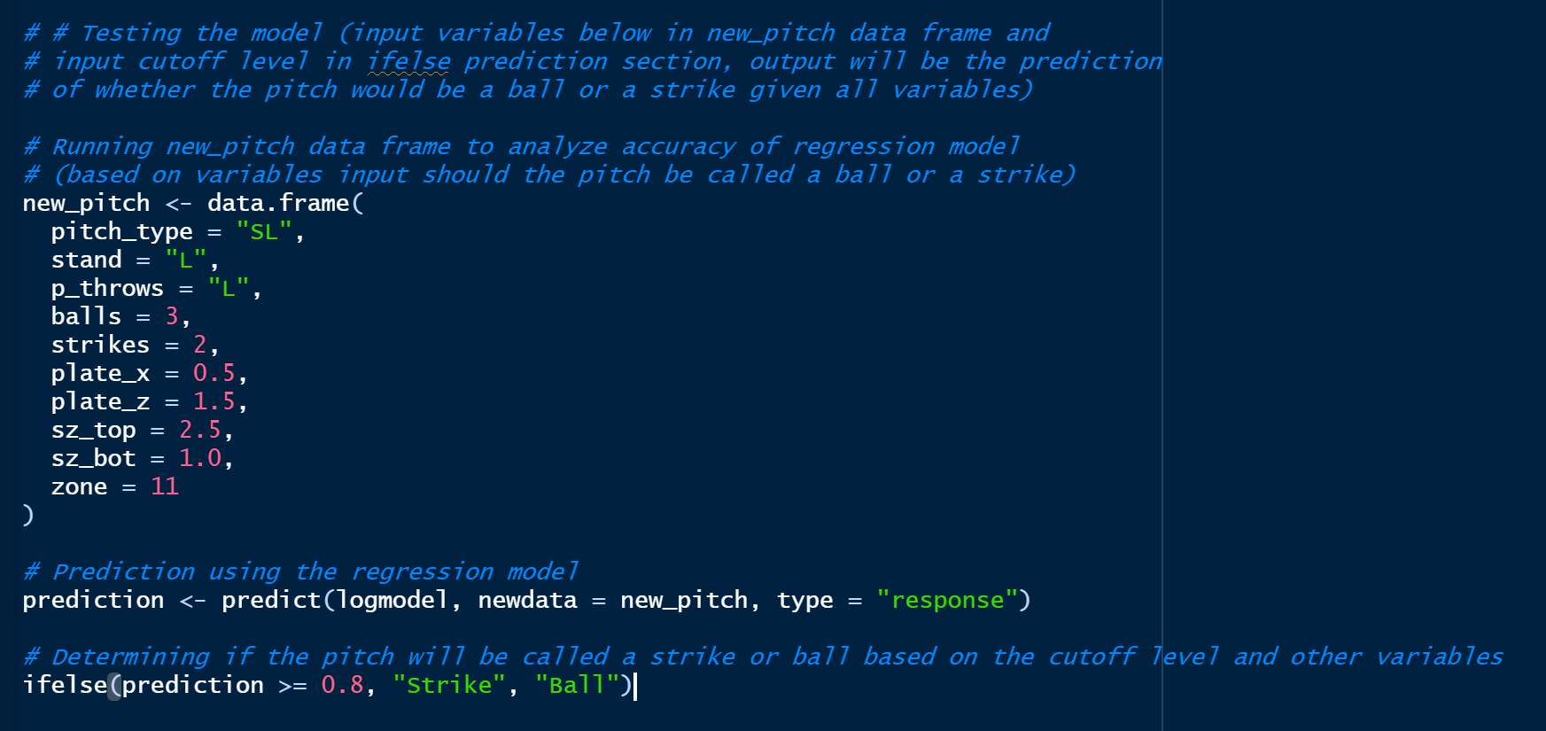
Evaluating the Model with Unseen Data
13

Slide 15
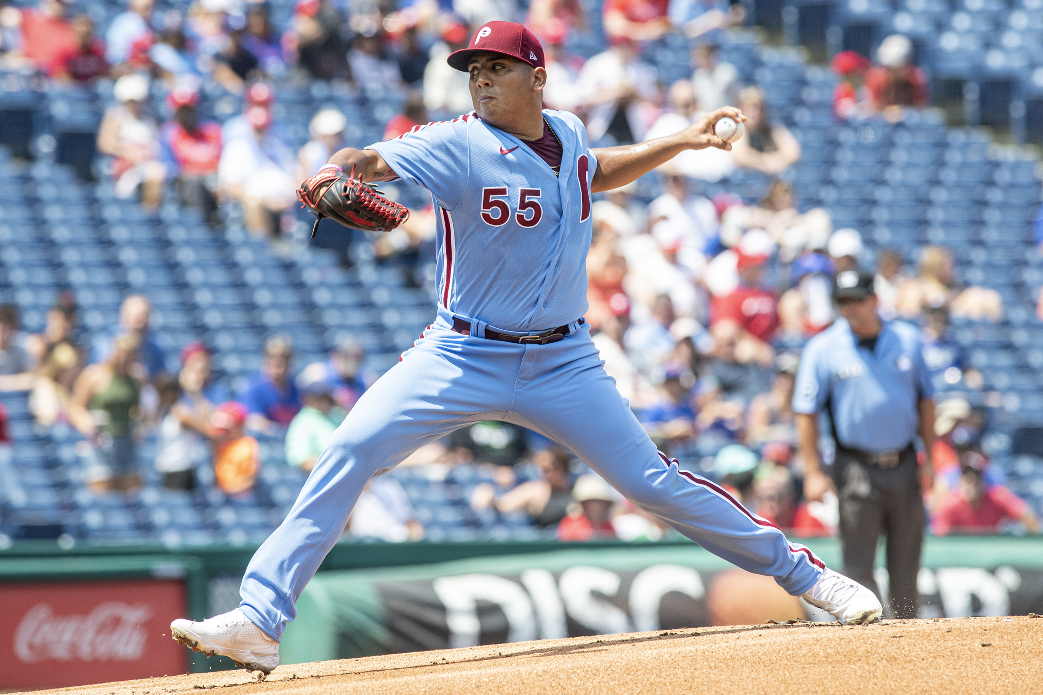
Limitations & Future Directions
Strong imbalance exists with twice as many balls as strikes in the data, potentially hurting performance
Model will lose performance over time with each new season, player, and umpire
Future data could include Umpire ID, Umpire Name, and ballpark elevation as these would have made good predictor variables
Future models could use tree-based classifiers like Decision Tree or Random Forest
Future model evaluation could include additional metrics such as F1, Precision, and Recall
14

Slide 16
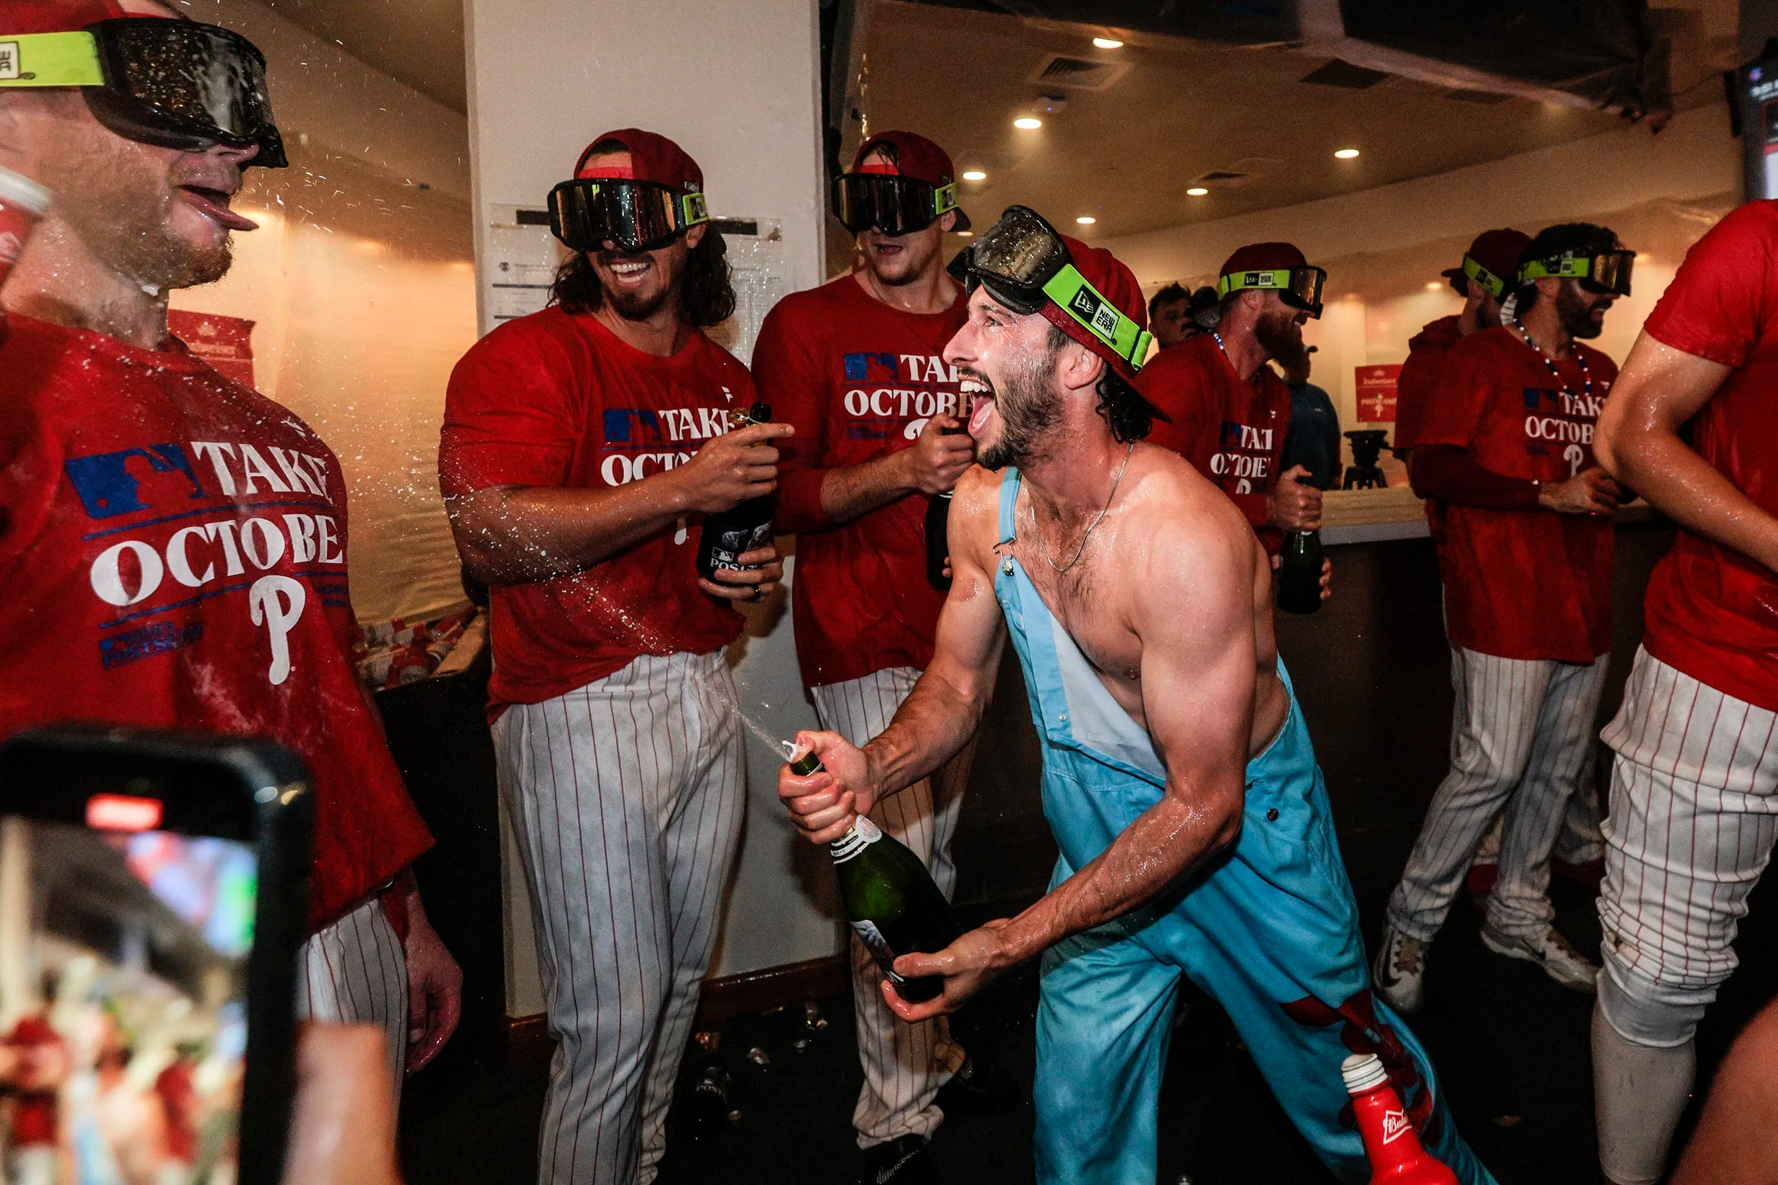
Conclusion
Our project aimed to estimate umpire calls for pitches in the 2022 MLB season
Regression analysis revealed what variables may be most significant in determining calls from umpire
Teams can use this model to identify pitch types more likely to result in strikes, optimize catcher positioning, and inform batter strategies
15

Slide 17





Questions? Connect on LinkedIn
Kale Wiley
Michael Mucciolo
Gibson Hurst
Cara Fredericks
16

Slide 18


Slide 19
References
Mills, B. M. (2023, October 9). Umpire Analytics. Society for American Baseball Research. https://sabr.org/journal/article/umpire-analytics/
Palmer, B. (2024, April 10). Believe it or Not, Umpires Are More Accurate Than Ever. Pitcher List. https://pitcherlist.com/believe-it-or-not-umpires-are-more-accurate-than-ever/#:~:text=But%20in%20every%20season%20since,improvement%20between%202008%20and%202023.
17

